Slide 1
Direct Market Access for Farmers Application Development Using Machine Learning
PIP4004 University Project-II
Final Review
Batch Number: ISR-06
Roll Number | Student Name
20211ISR0057 | AKSHAY B
20211ISR0060 | KARTHIK M SWAMY
20211ISR0076 | JERA PRAKASH
Under the Supervision of,
Dr . SIVARAMAKRISHNAN
School of Computer Science & Engineering
Presidency University

Slide 2
Agenda
ABSTRACT
INTRODUCTION
LITERATURE SURVEY
EXISTING SYSTEM and LIMITATIONS
PROPOSED SYSTEM/METHOD
METHODS/ALGORITMS/TECNOLOGY
OBJECTIVES
ARCHITECTURE
SOFTWARE COMPONENTS
TIMELINE OF THE PROJECT
EXPECTED OUTCOMES
CONCLUSION
REFERENCES

Slide 3
Abstract
This project presents a machine learning-based crop recommendation system using soil and environmental data to suggest the best crops for farmers. We trained Random Forest and Support Vector Machine (SVM) classifiers on an agricultural dataset, with Random Forest achieving the highest accuracy. A TensorFlow neural network was then trained to replicate Random Forest’s predictions, enabling mobile deployment. The model was converted to TensorFlow Lite (.tflite) format for offline use in Android apps. This system enhances farming decision-making and productivity by providing reliable crop recommendations and bridging the gap between AI and rural agriculture.

Slide 4
Introduction
A smartphone app connects farmers with customers and merchants, reducing reliance on middlemen and boosting income.
The app uses TensorFlow Lite and machine learning models to provide tailored crop recommendations based on environmental data.
Support Vector Machine and Random Forest classifiers were trained on soil and weather data, with Random Forest achieving 99.31% accuracy.
The system, powered by TensorFlow Lite, offers offline crop recommendations, benefiting farmers in remote areas without internet access.
The app includes a marketplace feature, improving market access and profitability for farmers while promoting sustainable farming practices.

Slide 5
Literature Review
Using ML for Crop Recommendation: Sharma et al. used SVM and Decision Trees for automated crop recommendation, achieving high accuracy with real datasets.
Intelligent Farming for Yield Optimization: Patil et al.'s smart farming model used machine learning for optimal crop yield prediction and adaptive learning.
AI & IoT in Agriculture: Mishra et al. combined IoT with AI for real-time disease detection and crop recommendations, improving farm management.
Deep Learning in Remote Sensing: Prasad and Kumar developed a deep learning system using satellite imagery for accurate large-area crop prediction.
Mobile App Using TensorFlow Lite: Verma and Joshi created an offline crop recommendation app with TensorFlow Lite, suitable for rural areas with limited internet.

Slide 6
Methodology
Dataset: Used Kaggle’s crop_recommendation.csv with key agricultural features (N, P, K, temp, etc.).
Random Forest Classifier: Chosen for high accuracy and robustness using ensemble decision trees.
Support Vector Machine: Used for comparison; effective but computationally expensive.
Evaluation: Accuracy and classification metrics favored Random Forest.
TensorFlow Model: Neural network mimicked Random Forest for mobile conversion.
Mobile App: Built in Android Studio using Java and XML with embedded TFLite model.

Slide 7
Existing method
Traditional Practices : Based on generational knowledge and trial-and-error, often lacking adaptability to modern challenges.
Government & Agricultural Advisory Services : Provide generalized recommendations with limited personalization and delayed response times.
Digital Platforms : Offer weather updates and farming tips but require internet access and don't provide location-specific or real-time support.
Manual Data Interpretation : Farmers often rely on personal judgment to interpret soil and climate data, leading to inconsistent decisions.

Slide 8
Limitations
Limited Dataset Scope: The model relies on a fixed dataset that may not reflect all regional conditions.
No Real-Time Data Integration: Lacks live updates from sensors or weather APIs for dynamic predictions.
Internet Dependency for Updates: Dataset/model updates require connectivity, limiting offline adaptability.
Neural Model Mimicry May Reduce Precision: The TensorFlow model may slightly lose accuracy replicating Random Forest.

Slide 9
Proposed Method
Real-Time Crop Suggestions: The app analyzes input parameters and provides crop recommendations offline using on-device machine learning.
Model Selection: SVM for baseline performance and Random Forest for high accuracy and robustness were considered.
Model Training & Evaluation: Random Forest outperformed SVM with 99.31% accuracy vs. 96.13%.
Crop Selection Based on Climate & Season: Suggests crops based on real-time weather, soil conditions, and seasonal factors.

Slide 10
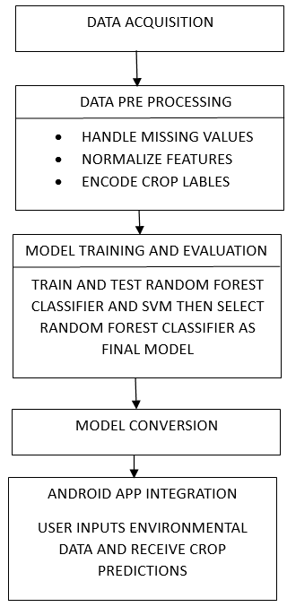
Workflow

Slide 11
Objectives
Develop a Real-Time Crop Recommendation System: Provide offline, immediate crop suggestions using on-device machine learning.
Evaluate and Compare Machine Learning Models: Train and assess SVM and Random Forest to choose the best-performing model for crop prediction.
Optimize Crop Selection: Recommend crops based on real-time weather, soil, and seasonal data for improved farming decisions.
Enhance Mobile Accessibility: Enable farmers to access crop recommendations without relying on continuous internet connectivity.

Slide 12
Software components
Android Studio : IDE for developing and testing the Android application.
Google Colab : Cloud-based Python environment for training and evaluating models.
Scikit-learn : For training and evaluating Random Forest Classifier (RFC), Support Vector Machine (SVM)
TensorFlow : For building and training the neural network model.
TensorFlow Lite Converter : For converting the neural network to .tflite format.

Slide 13
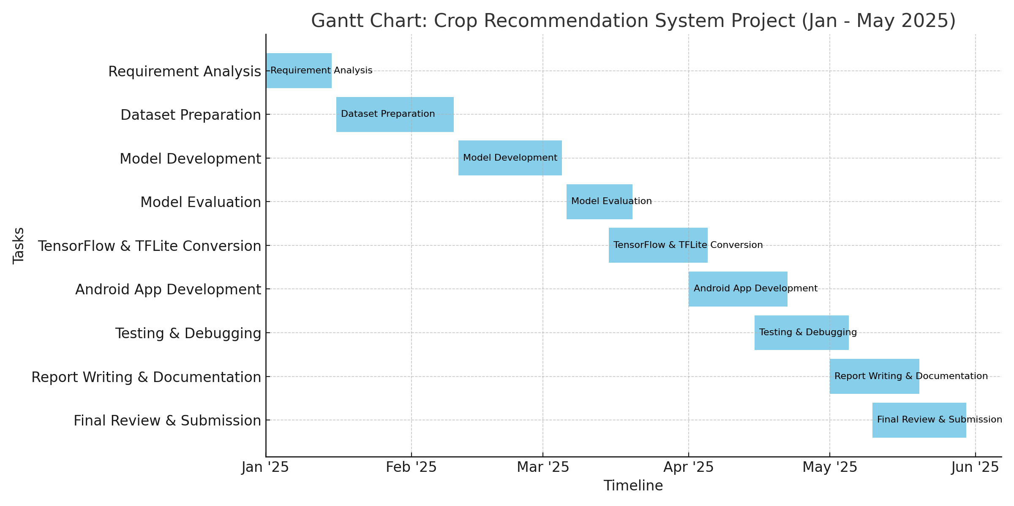
Timeline of Project

Slide 14
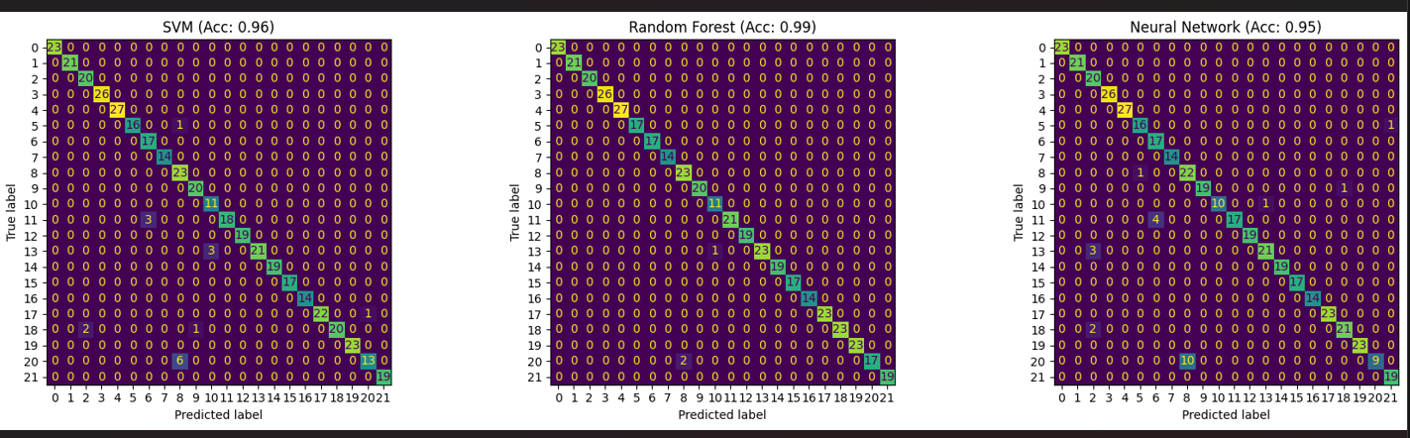
Expected Outcomes
comparison of SVM, Random forest classifier and neural network models .
Accuracy comparison of SVM (96.13%) and Random Forest Classifier (99.31%)

Slide 15
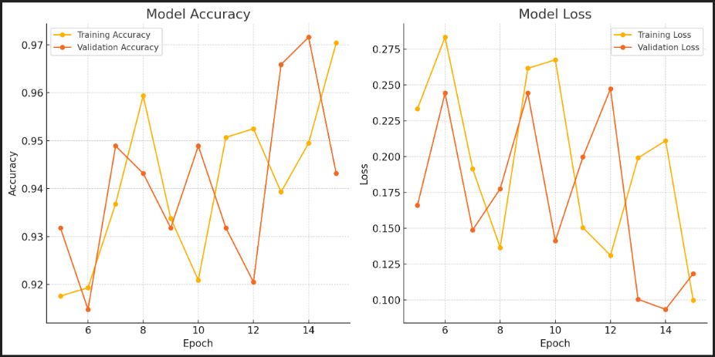
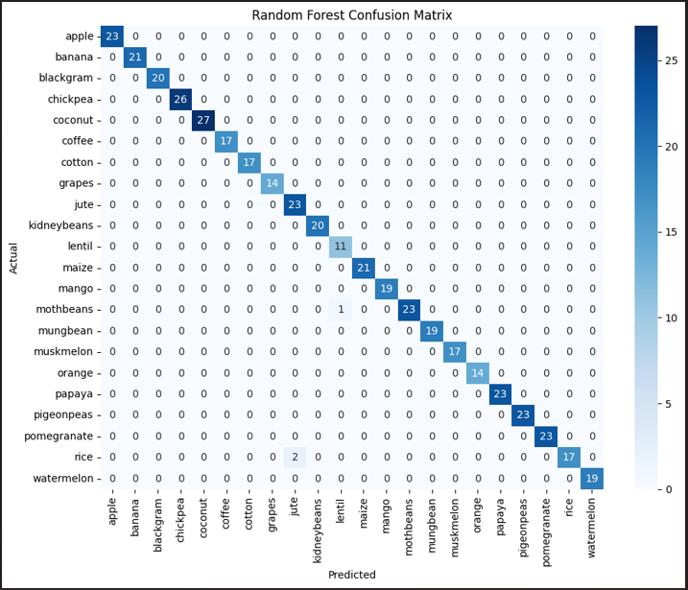
Expected Outcomes
Accuracy comparison of SVM (96.13%) and Random Forest Classifier (99.31%) for crop prediction, highlighting the superior performance of the Random Forest model is shown above.
Confusion matrix of the Random Forest Classifier showing near-perfect classification accuracy for crop prediction based on environmental and soil features is shown above.

Slide 16
Conclusion
This project presents the development of an intelligent crop recommendation system utilizing machine learning algorithms to suggest the most suitable crops based on soil and environmental parameters.Based on soil and climate parameters, the best crop was predicted using SVM and RandomForestclassifiers. With an accuracy of 99.31%, the Random Forest model outperformed the other one. After being translated to .TFlite, the chosen model was incorporated into an Android application. Farmers may enter figures into the app and get crop recommendations in real time.

Slide 17
References
[1] M. Sharma, V. Jain, and R. Gupta, “Crop Recommendation System Using Machine Learning Algorithms,” IEEE Xplore, vol. 9, pp. 1234-1240, 2022. Doi: 10.1109/ICRAI56067.2022.9876543.
[2] A. Patil, S. Deshmukh, and P. Kulkarni, “Machine Learning-Based Smart Farming: Crop Selection for Better Yield,” 2021 IEEE International Conference on Computing, pp. 210-215, 2021. Doi: 10.1109/ICCT51064.2021.9356738.
[3] R. K. Mishra, A. Sharma, and B. K. Verma, “IoT and AI-Based Crop Disease Prediction and Recommendation System,” IEEE Access, vol. 10, pp. 56345-56360, 2022. Doi: 10.1109/ACCESS.2022.9814532.
[4] S. R. Prasad and M. Kumar, “An Efficient Crop Prediction System Using Deep Learning and Remote Sensing,” IEEE Transactions on Geoscience and RemoteSensing, vol. 60, no. 5, pp. 1-8, 2023. doi: 10.1109/TGRS.2023.9684236.
[5] P. A. Verma and A. N. Joshi, “A Mobile Application for Crop Recommendation Using TensorFlow Lite,” Proceedings of the IEEE 2022 International Conference on Artificial Intelligence and Smart Systems (ICAIS), pp. 342-347, 2022. Doi: 10.1109/ICAIS54006.2022.9768574.
[6] K. Ramesh and P. B. Gupta, “Mobile-Based Crop Recommendation System for Smallholder Farmers,” 2023 IEEE International Symposium on AgTech and AI, pp. 102-108, 2023. Doi: 10.1109/AgTechAI57210.2023.9987654.
[7] A.Ingle,"CropRecommendation.csvDataset,"Kaggle,2020.[Online].Available:https://www.kaggle.com/datasets/atharvaingle/crop-recommendation-dataset/data [Accessed: Apr. 7, 2025].

Slide 18
Thank You

